Slide 1
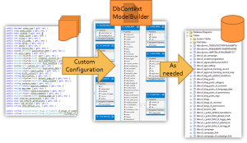
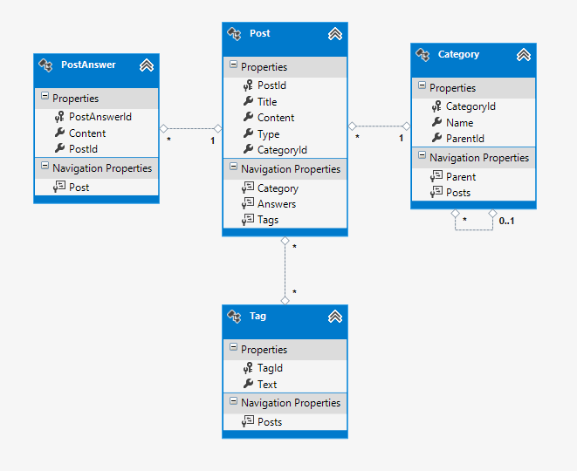



Entity Framework Code First
Databases
Telerik Software Academy
http://academy.telerik.com

Slide 2


Table of Contents
Modeling Workflow
Code First Main Parts
Domain Classes (Models)
DbContext and DbSets
Database connection
Using Code First Migrations
Configure Mappings
LINQPad
Repository Pattern

Slide 3
Modeling Workflow
Entity Framework supports three types of modeling workflow:
Database first
Create models as database tables
Use Management Studio or native SQL queries
Model first
Create models using visual EF designer in VS
Code first
Write models and combine them in DbContext

Slide 4
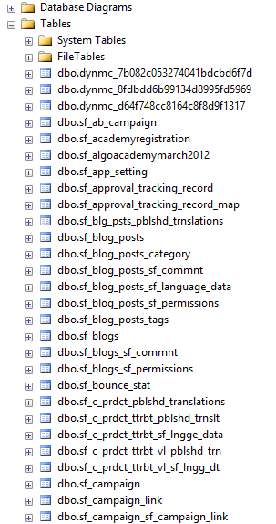
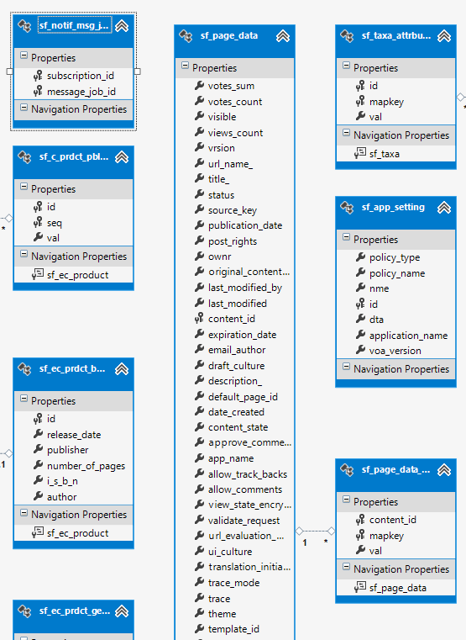
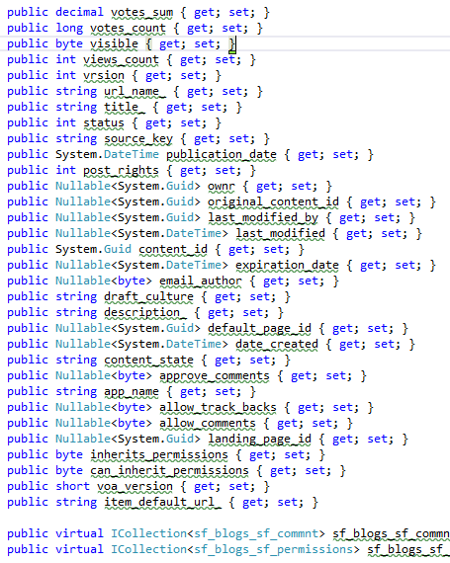
Database First Modeling Workflow
Create models as database tables and then generate code (models) from them

Slide 5
Model First Modeling Workflow

Slide 6
Code First Modeling Workflow
Domain classes
DbContext ModelBuilder
Custom Configuration
As needed

Slide 7
Why Use Code First?
Write code without having to define mappings in XML or create database models
Define objects in POCO
Reuse these models and their attributes
No base classes required
Enables database persistence with no configuration
Can use automatic migrations
Can use Data Annotations (Key, Required, etc.)

Slide 8

Code First Main Parts
Domain classes, DbContext and DbSets

Slide 9
Domain Classes (Models)
Bunch of normal C# classes (POCO)
May contain navigation properties
Recommended to be in a separate class library
Primary key
public class PostAnswer
{
public int PostAnswerId { get; set; }
public string Content { get; set; }
public int PostId { get; set; }
public virtual Post Post { get; set; }
}
Foreign key
Virtual for lazy loading
Navigation property

Slide 10
Domain Classes (Models) (2)
Another example of domain class (model)
public class Post
{
private ICollection<PostAnswer> answers;
public Post()
{
this.answers = new HashSet<PostAnswer>();
}
// ...
public virtual ICollection<PostAnswer> Answers
{
get { return this.answers; }
set { this.answers = value; }
}
public PostType Type { get; set; }
}
Prevents null reference exception
Navigation property
Enumeration

Slide 11

Demo: Creating Models
Creating domain classes (models)

Slide 12
DbContext Class
A class that inherits from DbContext
Manages model classes using DbSet type
Implements identity tracking, change tracking, and API for CRUD operations
Provides LINQ-based data access
Recommended to be in a separate class library
Don't forget to reference the Entity Framework library (using NuGet package manager)
If you have a lot of models it is recommended to use more than one DbContext

Slide 13
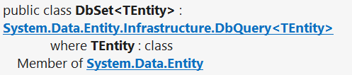
DbSet Type
Collection of single entity type
Set operations: Add, Attach, Remove, Find
Use with DbContext to query database
public DbSet<Post> Posts { get; set; }

Slide 14
DbContext Example
using System.Data.Entity;
using CodeFirst.Models;
public class ForumContext : DbContext
{
public DbSet<Category> Categories { get; set; }
public DbSet<Post> Posts { get; set; }
public DbSet<PostAnswer> PostAnswers { get; set; }
public DbSet<Tag> Tags { get; set; }
}

Slide 15
Demo: Creating DbContext

Slide 16
How to Interact With the Data?
In the same way as when we use database first or model first approach
var db = new ForumContext();
var category = new Category { Parent = null, Name = "Database course", };
db.Categories.Add(category);
var post = new Post();
post.Title = "Срока на домашните";
post.Content = "Моля удължете срока на домашните";
post.Type = PostType.Normal;
post.Category = category;
post.Tags.Add(new Tag { Text = "домашни" });
post.Tags.Add(new Tag { Text = "срок" });
db.Posts.Add(post);
db.SaveChanges();

Slide 17
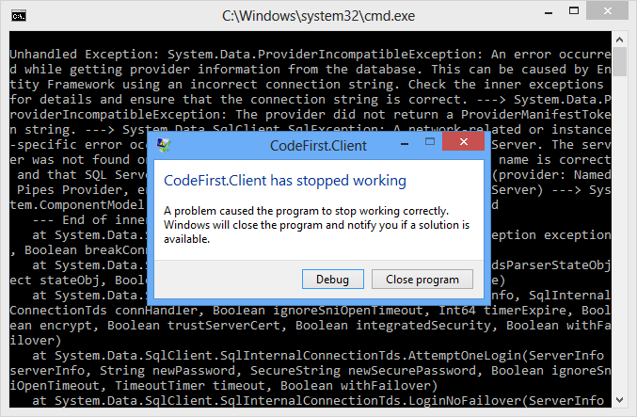
Demo: Using The Data

Slide 18
Where is My Data?
By default app.config file contains link to default connection factory that creates local db
Server name by default: (localdb)\v11.0 or .\SQLEXPRESS.[full-class-name]
We can use VS server explorer to view database
<entityFramework>
<defaultConnectionFactory type="System.Data.Entity.Infrastructure.LocalDbConnectionFactory, EntityFramework">
<parameters>
<parameter value="v11.0" />
</parameters>
</defaultConnectionFactory>
</entityFramework>

Slide 19
How to Connect to SQL Server?
First, create context constructor that calls base constructor with appropriate connection name
public class ForumContext : DbContext
{
public ForumContext()
: base("ForumDb")
{ }
// ...
}
Then add the connection string in app.config
Server address might be .\SQLEXPRESS
<connectionStrings>
<add name="ForumDb" connectionString="Data Source=.;Initial Catalog=ForumDb;Integrated Security=True" providerName="System.Data.SqlClient" />
</connectionStrings>

Slide 20
Database Connection Workflow
Connection String Available?
Database Exists?
Use Database
Build String (SQL Server Express or Create Local DB)
Create Database

Slide 21
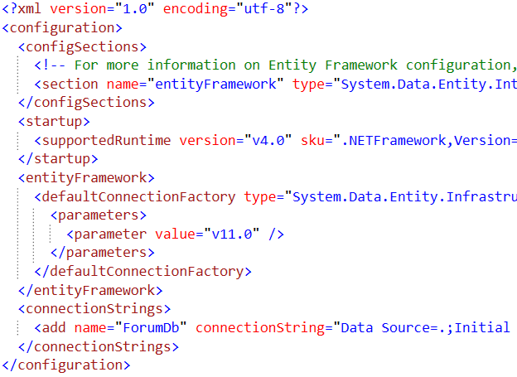
Demo: Change Database Connection

Slide 22

Using Code First Migrations

Slide 23

Changes in Domain Classes
What happens when we change our models?
Entity Framework compares our model with the model in __MigrationHistory table
By default Entity Framework only creates the database and don't do any changes after that
Using Code First Migrations we can manage differences between models and database

Slide 24
Code First Migrations
Enable Code First Migrations
Open Package Manager Console
Run Enable-Migrations command
This will create some initial jumpstart code
-EnableAutomaticMigrations for auto migrations
Two types of migrations
Automatic migrations
Set AutomaticMigrationsEnabled = true;
Code-based (providing full control)
Separate C# code file for every migration

Slide 25
Database Migration Strategies
CreateDatabaseIfNotExists (default)
DropCreateDatabaseIfModelChanges
We loose all the data when change the model
DropCreateDatabaseAlways
Great for automated integration testing
MigrateDatabaseToLatestVersion
This option uses our migrations
We can implement IDatabaseInitializer if we want custom migration strategy

Slide 26
Use Code First Migrations
First, enable code first migrations
Second, we need to tell to Entity Framework to use our migrations with code (or app.config)
We can configure automatic migration
Database.SetInitializer( new MigrateDatabaseToLatestVersion
<ForumContext, Configuration>());
This will allow us to delete or change properties
public Configuration()
{
this.AutomaticMigrationsEnabled = true;
this.AutomaticMigrationDataLossAllowed = true;
}

Slide 27
Seeding the Database
During a migration we can seed the database with some data using the Seed method
This method will be run every time (since EF 5)
protected override void Seed(ForumContext context)
{
/* This method will be called after migrating to
the latest version. You can use the
DbSet<T>.AddOrUpdate() helper extension method
to avoid creating duplicate seed data. E.g. */
context.Tags.AddOrUpdate(new Tag { Text = "срок" });
context.Tags.AddOrUpdate(new Tag { Text = "форум" });
}

Slide 28

Demo: Code First Migrations

Slide 29

Configure Mappings
Using Data Annotations and Fluent API

Slide 30

Configure Mappings
Entity Framework respects mapping details from two sources
Data annotation attributes in the models
Can be reused for validation purposes
Fluent API code mapping configuration
By overriding OnModelCreating method
By using custom configuration classes
Use one approach or the other

Slide 31
Data Annotations
There is a bunch of data annotation attributes in System.ComponentModel.DataAnnotations
[Key] – specifies the primary key of the table
For validation: [StringLength], [MaxLength], [MinLength], [Required]
Schema: [Column], [Table], [ComplexType], [ConcurrencyCheck], [Timestamp], [ComplexType], [InverseProperty], [ForeignKey], [DatabaseGenerated], [NotMapped], [Index]
In EF 6 we will be able to add custom attributes by using custom conventions

Slide 32
Fluent API for Mappings
By overriding OnModelCreating method in DbContext class we can specify mapping configurations
protected override void OnModelCreating(DbModelBuilder modelBuilder)
{
modelBuilder.Entity<Tag>().HasKey(x => x.TagId);
modelBuilder.Entity<Tag>().Property(x => x.Text).IsUnicode(true);
modelBuilder.Entity<Tag>().Property(x => x.Text).HasMaxLength(255);
// modelBuilder.Entity<Tag>().Property(x => x.Text).IsFixedLength();
base.OnModelCreating(modelBuilder);
}

Slide 33
Fluent API Configurations
.Entity()
Map: Table Name, Schema
Inheritance Hierarchies, Complex Types
Entity -> Multiple Tables
Table -> Multiple Entities
Specify Key (including Composite Keys)
.Property()
Attributes (and Validation)
Map: Column Name, Type, Order
Relationships
Concurrency

Slide 34

Demo: Configure Mappings

Slide 35

LINQPad

Slide 36
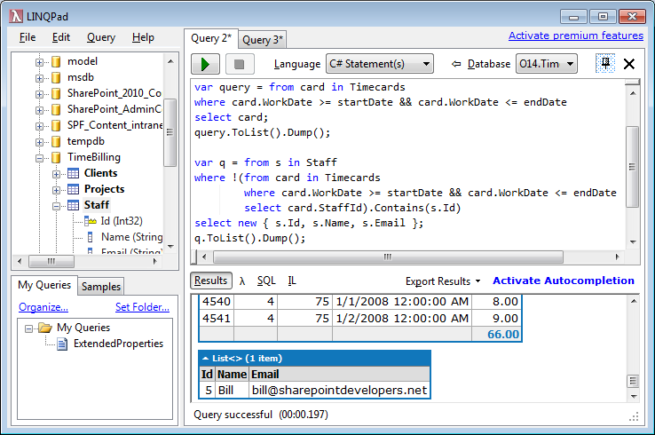
LINQPad
Download from: http://www.linqpad.net/
Supports native C# 5.0
Translates it to SQL, XML, Objects
Understands LINQ
Free and paid version

Slide 37
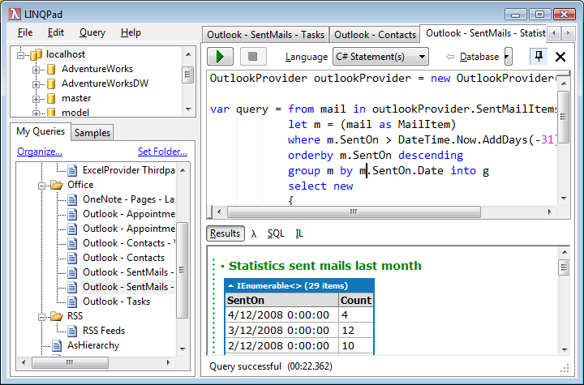
Demo: LINQ Pad

Slide 38
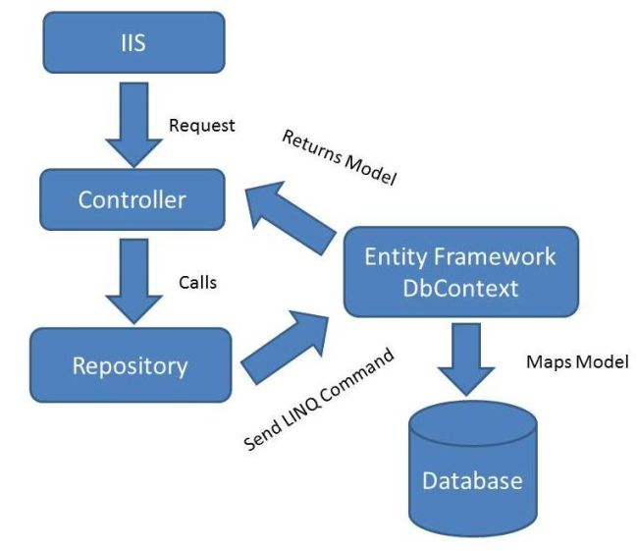
Repository Pattern

Slide 39
Repository Pattern
Gives abstraction over the data layer
Single place to make changes to your data access
Single place responsible for a set of tables
Easily replaceable by other implementations
Hides the details in accessing data
Can be implemented in various ways

Slide 40


Demo: Repository Pattern

Slide 41
Entity Framework Code First
http://academy.telerik.com

Slide 42
Homework
Using c0de first approach, create database for student system with the following tables:
Students (with Id, Name, Number, etc.)
Courses (Name, Description, Materials, etc.)
StudentsInCourses (many-to-many relationship)
Homework (one-to-many relationship with students and courses), fields: Content, TimeSent
Annotate the data models with the appropriate attributes and enable code first migrations
Write a console application that uses the data
Seed the data with random values

Slide 43




Free Trainings @ Telerik Academy
C# Programming @ Telerik Academy
csharpfundamentals.telerik.com
Telerik Software Academy
academy.telerik.com
Telerik Academy @ Facebook
facebook.com/TelerikAcademy
Telerik Software Academy Forums
forums.academy.telerik.com

